Slide 1
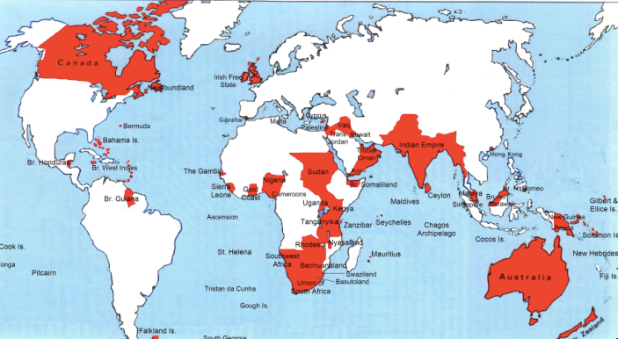

Lecture: 3.3.1. Empire & Underdevelopment
3:15 of audio in this slide; 11:15 in this slide group
Notes:
1870 saw the greatest empire the world has ever seen—the British Empire—approaching its peak. And this empire had both “formal” and “informal” aspects.
1945 saw the supersession of Britain by the United States as the leading industrial and commercial and imperial power. It sees the creation of an American empire that is definitely not “formal” but rather “informal”—but that is a story of the 1930s and thereafter, not of the years before 1914.
Europe—or, rather, Spain and Portugal—started building empires in the 1500s. It was not that they had unique technological or organizational powers to do so. What made the European empires different, however, was that they had interlocking rationales. They made political-military, ideological-religious, and economic sense. Spain’s conquistadores set out to serve the king, to spread the word of God, and to get rich.
Other adventurers and imperialists did not have this triple reinforcing dynamic. When the Portuguese arrived in what is now Malaysia in the 1500s, they met political-military opposition from local rulers, ideological-religious opposition from Islamic communities, and economic opposition from Chinese traders who did not want to be displaced.
But Chinese merchants had no political backing from Ming rulers, who regarded them as out-of-control.
Local sultans could not summon religious-ideological energy for crusades to expel the Portuguese from their bases.
And Islamic communities’ well-being was not profitable enough to far-away allies to generate sustained intervention.
For European adventurers, kings and guns, God and congregations, and money and trade reinforced one another. And so the European overseas empires of the 1500s and thereafter grew.
These early empires were, however, limited. Outside of the Americas, the sea became European but the land did not. Sea control, however, did mean a great deal. In the 1500s and 1600s control over the high-value low-weight luxury goods of East Asia, or over the precious metals of Latin America, made individuals’ fortunes, while also providing healthy boosts to early modern European royal treasuries, places for potentially disruptive young males, and ways for accompanying missionaries to believe they pleased their God. In the 1600s and 1700s the tobacco and slave trades plus the sugar-growing islands of the Caribbean boosted mercantile prosperity and government treasuries. West Indian empires become a focus of high politics, and a driver of then-slow economic growth. Plus the slave trade devastated Africa, and plausibly created the conditions that today keep Africa the poorest continent.

Slide 2
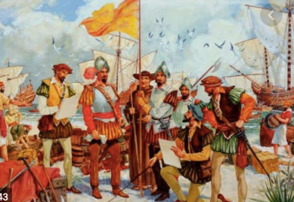
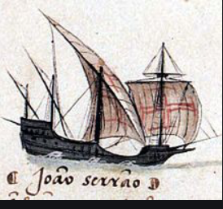
By 1810 the Tide of Empire Was Clearly Ebbing…
Little in the way of luxuries that could not be made more cheaply in the industrial core of the world economy:
Plus conquest was expensive
By contrast, trade was cheap
And maintaining hold on the conquests was even more expensive: the local notables whom governments usually relied on as intermediaries were the most likely to staff a pro-independence movement
Thus the odds were that it would be more expensive to conquer and then extract than to trade
Much of North America had already broken away from England over 1776-1783
The decade of the 1810s saw Latin America gain its independence as well…
1:15 of audio in this slide
Notes:
But come the 1800s the tide of empire appeared to be clearly ebbing. Conquest, unless the technology and organizational gradient is immense, is usually expensive. Trade, by contrast, is cheap. Moreover, people in distant countries and regions are happy to send you your stuff if you send them valuable stuff in the way of consumer goods. They are less happy if you try to conquer them and make them give you their stuff for free.
Moreover, maintaining hold on conquests was even more expensive: the local notables whom governments usually relied on as intermediaries were the most likely to staff a pro-independence movement
Thus the odds were that it would be more expensive to conquer and then extract than to trade. Much of North America had already broken away from England over 1776-1783. The decade of the 1810s saw Latin America gain its independence as well.
And that trend continued up until 1850 or so. Yes, Britain conquered India—but that was freakish good or bad luck. Yes, France conquered Algeria—but that took a large national effort for a place next door. France failed to conquer Mexico. By and large, Europeans ruled the seas and the coasts, but further? Difficult and costly. Until 1870 or so.

Slide 3
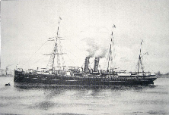
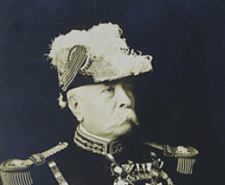
Yet After 1860 Empires Grew…
Industrialization made the power gradient immense:
“We have the Maxim gun, and they have not”
No place in which western Europeans could not impose their will by armed force:
Proconsuls were rarely focused on resource flows
Whether it might not be cheaper in the long run to simply trade
Omdurman in Sudan in 1898
10,000 soldiers of the Mahdist Sudanese regime died.
Only 48 British and Egyptian soldiers died
2:00 of audio in this slide
Notes:
Yet after 1860 empires grew.
The power gradient—technological, organizational, political—had become immense.
The improvements in transport and communications made war and conquest and occupation vastly easier. There was no part of the world in which western Europeans could not—if they wished—impose their will by armed force at moderate cost. And proconsuls were rarely focused on just what resources would flow back to the imperial metropolis from this extension of empire, and whether it might not be cheaper in the long run to simply trade and pay for them.
At the battle of Omdurman in the Sudan in 1898, 10,000 soldiers of the Mahdist Sudanese regime died. Only 48 British and Egyptian soldiers died. The difference was not entirely due to superior European military technology. The Mahdist regime did have proto-machine-guns, telegraphs, and mines—all bought from European suppliers. What it did not have was the organizational capacity and discipline to make effective use of them.
The outcome all across the globe was integration into the European dominated world economy, political submission—either formal or informal—to rule by European proconsuls, and the spread of European languages and European views of life around the globe. Missionaries brought European religions. Proconsuls interested in uplift brought European-style schools. Europe-originated culture, methods of administration, science, and technology began to percolate down. Members of future peripheral elites were taught as part of a civilizing mission—in French—how “our ancestors the Gauls” had fought the Romans in the first century B.C. Harbors, railroads, factories, and plantations sprung up from Bali in what is now Indonesia to Accra in what is now Ghana.
And everywhere peoples were taught that they were dirt under the feet of their European rulers.

Slide 4
Divergent Experiences
Arthur Lewis:
“The imperialists tell us… good government. The anti-imperialists argue… that empire… outlived its time… was irrelevant to development… held back development… de-developed…. Colonies were governed very differently…. One could nominate at least one country to fit each of these categories, from best to worst...”
The anti-colonialists seem to me to have the better of the argument
Did imperial powers follow growth-promoting policies in the colonies? By and large not.
Plus there were abattoirs like the Belgian Congo:
Listen to the sound of Leopold’s ghost/Yelling in hell for his hand-maimed host…
1:30 of audio in this slide
Notes:
Still, very different things were happening in different corners of the world: the only constant of formal empire was that there was nothing constant. As Arthur Lewis put it in his Growth and Fluctuations, 1870-1913:
>The imperialists tell us… good government. The anti-imperialists argue… that empire… outlived its time… was irrelevant to development… held back development… de-developed….
>Colonies were governed very differently…. One could nominate at least one country to fit each of these categories, from best to worst...
But by and large the anti-colonialists seem to me to have the better of the argument. Successful and rapid economic development in the nineteenth century required a government to build railroads, ports, and urban infrastructure; a government to establish schools; a government to create a legal framework for banking, and then for banks to pool the savings of the people and distribute them to what were for the time large-scale capital-hungry enterprises. And it required tariffs to keep nascent and infant industrial sectors from being squashed by foreign factory imports, and so provide room for businesses and engineers to learn how to run factories by doing, and so for communities of engineering expertise to develop and grow.
Colonial governments were somewhat interested in ports. But they were rarely if ever interested in the rest. Independent governments might well not find themselves following growth-promoting industrial polices. But they had a chance of doing so.
Plus there were abattoirs like the Belgian Congo, with King Leopold’s ghost yelling in hell for his hand-maimed host.

Slide 5
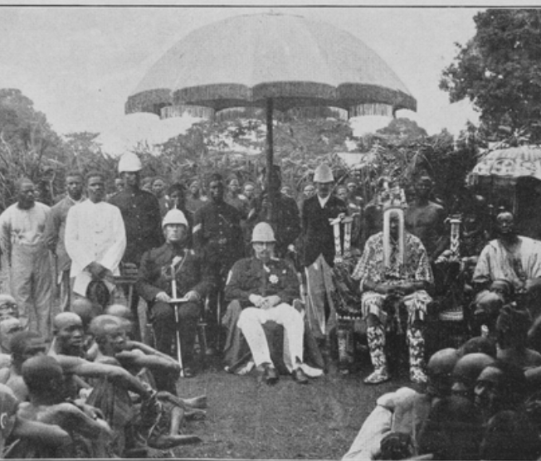
The Colonized Experience
The standard package for successful development;
Market-promoting government;
Building railroads, canals and ports;
Chartering banks for commerce and investment;
Establishing mass education
Imposing smart tariffs on those manufactured imports that would in the short-run crowd out production and thus the creation of the communities of engineering practice
Colonial masters would not allow the standard package
Neverthless, progress:
Even outside of the global north the world was far richer in 1950 than it had been in 1800
The center-of-gravity of what now is the global south was at a living standard of $2 a day in 1800s
$2.25 by 1870
$3.50 by 1913.
But still about $3.50 by 1950.
However, there were a number of economies that seemed to be taking advantage of opportunities:
Japan
Those parts of Latin America that escaped internal colonization by landed and bureaucratic elites
But the gap between global north and global south had grown: from 2.5 to 1 in 1800 to 4 to 1 in 1870 and 1913, and to 7 to 1 by 1950.
3:15 of audio in this slide
Notes:
Stable market-promoting government; building railroads, canals and ports; chartering banks for commerce and investment; establishing mass education; and imposing tariffs on those manufactured imports that would in the short-run crowd out production and thus the creation of the communities of engineering practice in those modern industries in which long-run comparative advantage lay—those were what Robert Allen and others have judged to have been the essentials for stepping on to the escalator of prosperity that was post-1970 modern economic growth.
But for the colonized in Asia and Africa before World War II that was not a possibility: they could not do that. Their colonial masters had little interest in and provided no support for such policies. And the competition that their natural resource products and their workers faced from the products and workers or extremely low-wage India and China crippled the wealth of a middle class that might otherwise have provided demand to spur industry, and made globalization more the foe than the friend of economic development.
How about Latin America, which had achieved independence from Spain and Portugal early in the 1800s? How did they do before World War II? Mexico, Columbia, Peru, Brazil, and the others suffered, by and large, from what one might call internal colonialists: a landed elite privileged by property ownership and Iberian descent that feared an educated proletariat, loved foreign-made manufactures, and had Iberian-derived legal systems that did not mesh well with the needs of commerce and industry.
Do not get me wrong: outside of the global north the world was far richer in 1950 than it had been in 1800, and richer by a substantial margin. If the center-of-gravity of what now is the global south was at a living standard of $2 a day in 1800s and $2.25 by 1870, it was about $3.50 by 1913. But, dragged down by China in war and revolution and by an India that had been heavily hit by the disruptions of trade that came with the Great Depression and then war, it was still about $3.50 by 1950. But there were a number of economies that seemed to be taking advantage of opportunities: Japan had already joined the industrial powers. Those parts of Latin America that escaped internal colonization by landed and bureaucratic elites were looked to be catching up: Chile, Argentina, Uruguay, and southern Brazil still looked more like a cross between an Australia and an Italy than like the externally or internally colonized. Venezuela had its oil boom. Cuba and Costa Rica showed signs of escape. Iran, Iraq, Lebanon, Egypt, Morocco, and Algeria; South Africa, Kenya, Zambia, Ghana, and Nigeria; Mexico and Peru all formed a global middle stratum.
But the gap between global north and global south had grown: from 2.5 to 1 in 1800 to 4 to 1 in 1870 and 1913, and to 7 to 1 by 1950.

